Slide 1
Physics in Circuits and Gadgets

Slide 2
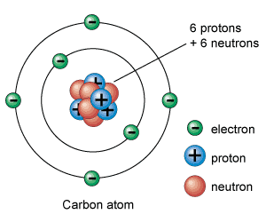
Kinds of Electric Charges
Positive charge
negative charge
Unit : Coulomb, C
www.universetoday.com

Slide 3
Electric charge
The charged particles — electrons and protons — have the same magnitude of charge, which is
e = 1.6 × 10⁻¹⁹ C
www.universetoday.com

Slide 4
Charge and Charge Interactions
Positively Charged | Uncharged/ Neutral | Negatively Charged
More protons than electrons | Equal number of protons and electrons | More electrons than protons
198.185.178.104
www.universetoday.com

Slide 5
Insulator and Conductor
Insulator - hold their electrons very tightly
e.g., wood, plastic
Conductor – loosely held electrons, which move through them easily
e.g., metals

Slide 6
Conservation of Charges
Properties of Charges
Charges are neither created nor destroyed. They transfer from one object to another.

Slide 7
Quantization of Charges
Properties of Charges
Electric charge (Q) always occurs as some integral multiple of the fundamental charge e
n= 1, 2, 3…

Slide 8
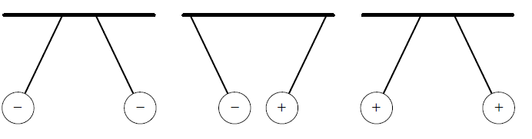
Law of Electrostatics
Like charges REPEL, unlike charges ATTRACT
Holzner, Stephen. 2006. Physics for Dummies. Wiley Publishing

Slide 9
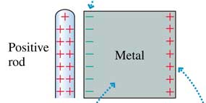
Electric polarization
corresponds to a rearrangement of the charges in the material.

Slide 10
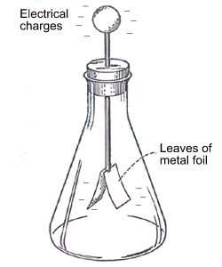
Electroscope
device that detects static electricity by using thin metal, which separate when charged.

Slide 11
Charging
Possible ways of charging an object:
By friction
By conduction
By induction

Slide 12
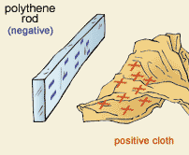
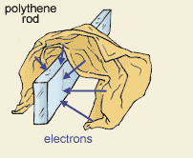
Charging by Friction

Slide 13
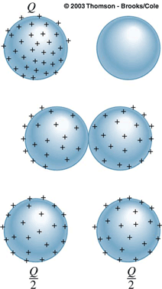
Charging by Conduction
With direct contact
Before contact
During contact
After contact
Charges directly transfer to the other body
whs.wsd.wednet.edu

Slide 14
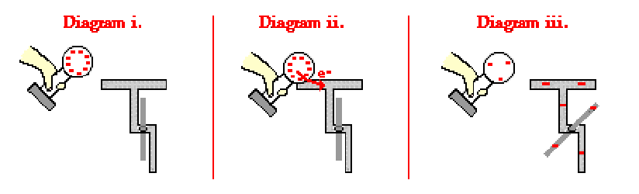
Charging by Conduction
Before contact
During contact
After contact
whs.wsd.wednet.edu

Slide 15
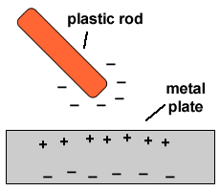
Charging by Conduction
contact
Negative-negative repel

Slide 16
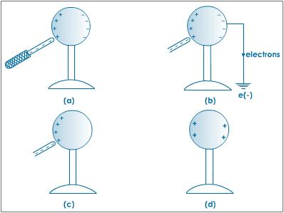
Charging by Induction
With no direct contact
Step 1: Polarization: separation of charges
tutorvista.com

Slide 17
Charging by Induction
Step 2: Grounding: expelling of one kind of charges
Step 3: Creation of charged body
tutorvista.com

Slide 18
Charging by Induction
Possible Consequence: Spark
tutorvista.com

Slide 19
Charging by Induction

Slide 20
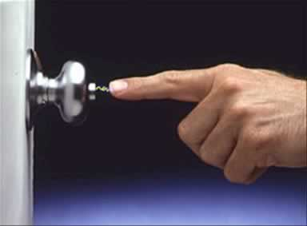
Charging by induction
www.school-for-champions.com

Slide 21
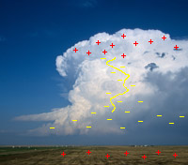
Charging by Induction

Slide 22
Charging by Induction
+
+
+
+
+
+
+
+
+
+
+
+
-
-
-
-
-
-

Slide 23
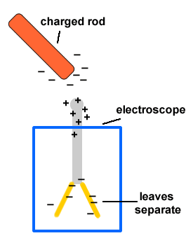
Charging by Induction

Slide 24
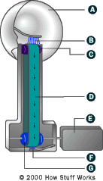
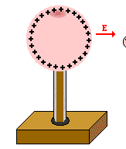
Van de Graaf Generator
Generates a “charged sphere”

Slide 25
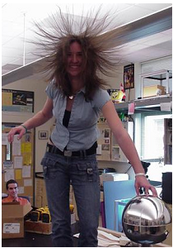
If you hold the sphere of a Van de Graaf generator, what will happen?

Slide 26
Van de Graaf Generator
+
Same charges repel
+
+
Charging by conduction

Slide 27
Parallel Plate
-
-
-
-
-
Charging by induction
+,+ repel
+
+
+
Charging by conduction
+
+
+
+
+
+
+
Van de Graaf Generator

Slide 28
Ringing Bell
+
+
-
-
+
-
-
-
+
+
Charging by induction
+
+
Van de Graaf Generator

Slide 29
Ringing Bell
+
+
-
-
+
-
-
-
+
+
Opposite charges attract
+
+
Van de Graaf Generator

Slide 30
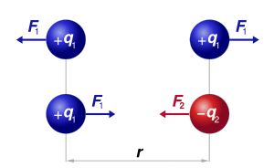
Coulomb’s Law
The magnitude of the Electrostatic Force (F) is directly proportional with the magnitude of the charges (q1 and q2)

Slide 31
Coulomb’s Law
The magnitude of the Electrostatic Force (F) is inversely proportional with the square of the distance (r²)

Slide 32
Coulomb’s Law
The magnitude of the Electrostatic Force (F) :
k = Coulomb’s constant (8.99 x 10⁹ Nm²/C²)

Slide 33
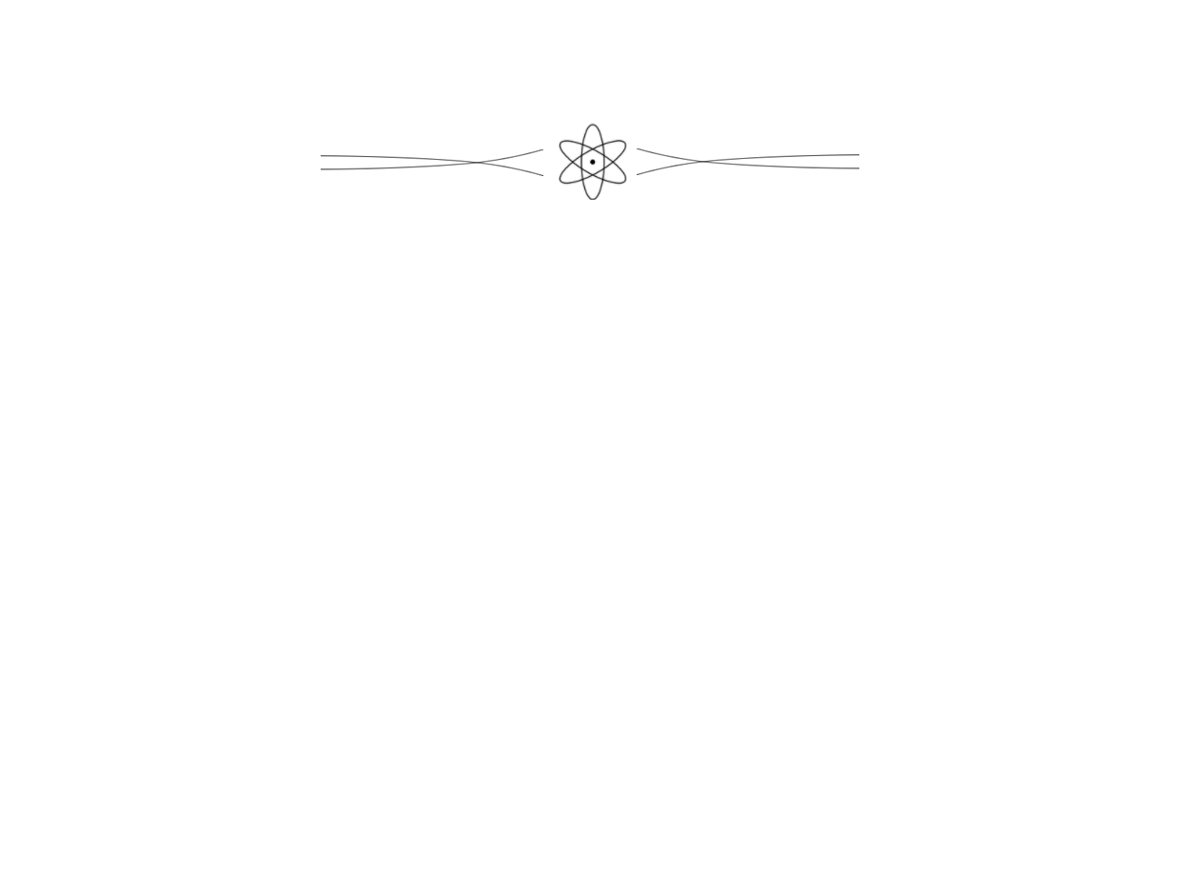
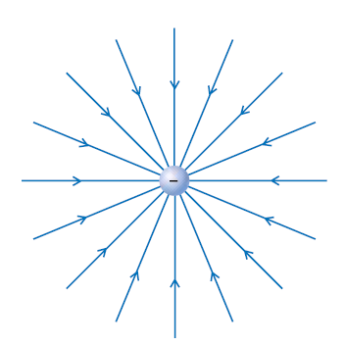
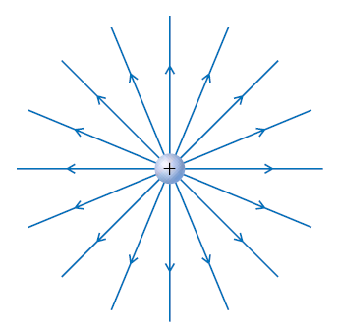
Electric Field
Region in space wherein charges would experience electrostatic force

Slide 34
Electric Field Strength
Electric field (E) is the electrostatic force (F) per unit charge (q)

Slide 35
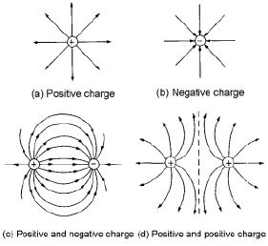
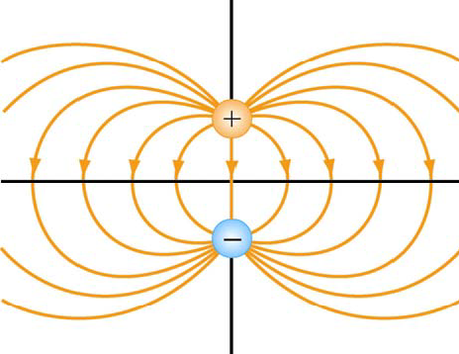
Electric Field
begins on positive charges (or at infinity) and ends on negative charges (or at infinity)
field lines do not cross !!!

Slide 36
Electric Field
the density of lines at any point is proportional to the magnitude of the field at the point
High E
Low E

Slide 37
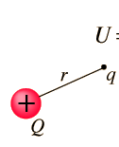
Electrostatic Potential Energy (U)
Work needed to bring the charges from an infinite separation to their final position (r)
Unit: Joules

Slide 38
Electrostatic Potential (V)
Electric potential energy (E) per unit charge (q)
Unit: volts (V)
Note: Electric potential energy (E) is different from Electric potential (V)

Slide 39
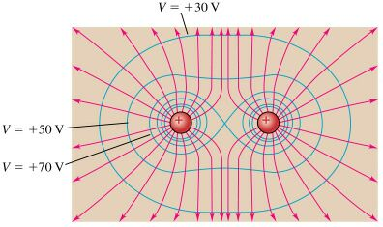
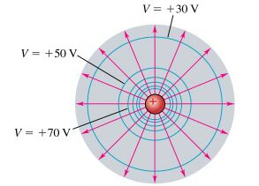
Equipotential surface
set of points at the same electrostatic potential
Blue line – equipotential surface
Red line – electric field lines

Slide 40
Equipotential surface
Equipotential surface is perpendicular to the electric field lines

Slide 41
Potential Difference (Voltage)
Associated with the work done (or energy required) to move a unit positive charge from one point to another.
Unit: Volts
+ 5V
Potential Difference = 3V
+ 2V
Equipotential Surface
www.one-school.net

Slide 42
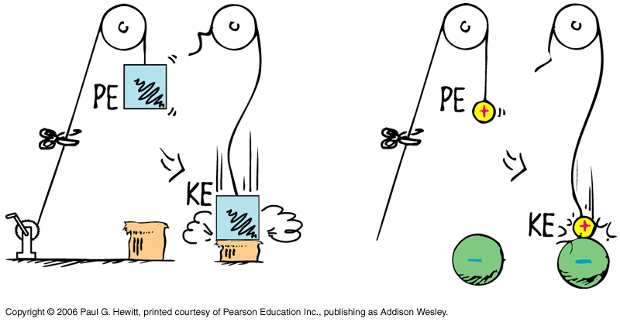
Potential Difference (Voltage)
Movement of positive charges:
higher potential → lower potential

Slide 43

Potential Difference (Voltage)
If there is Potential Difference or Voltage, positive charges will move from
higher potential → lower potential
+ 5V
Potential Difference = 3V
+ 2V

Slide 44

Voltage
Higher Potential
Lower Potential

